Slide 1
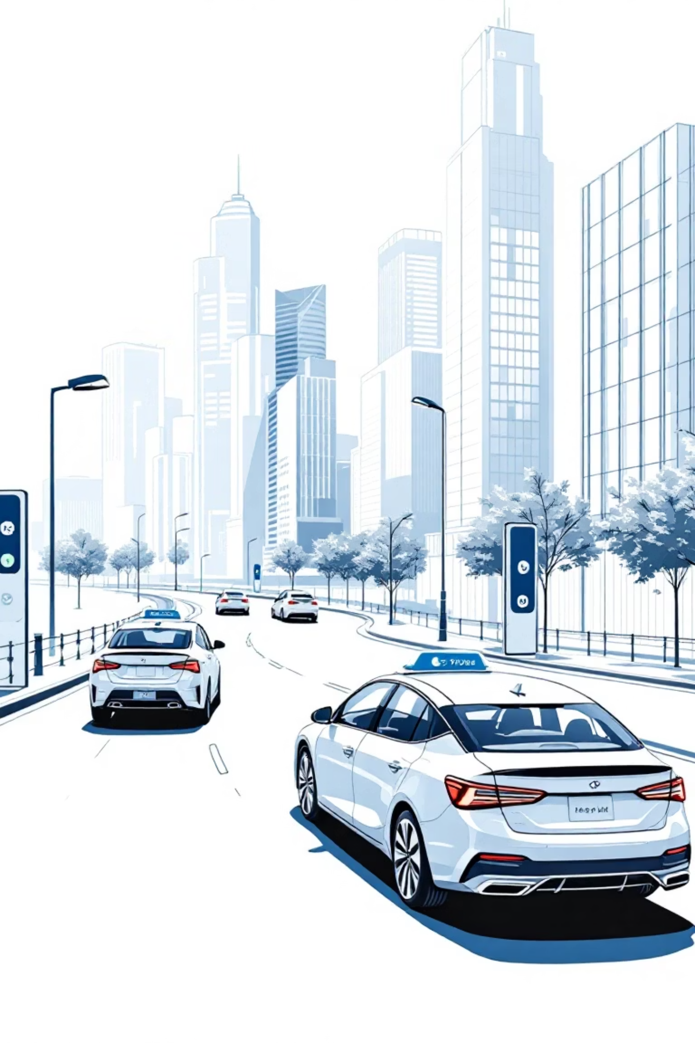
Dynamic Ride-Sharing and Carpooling Platform
Mentor: Mr. Sainath
Coordinator: Miss Disha

Slide 2
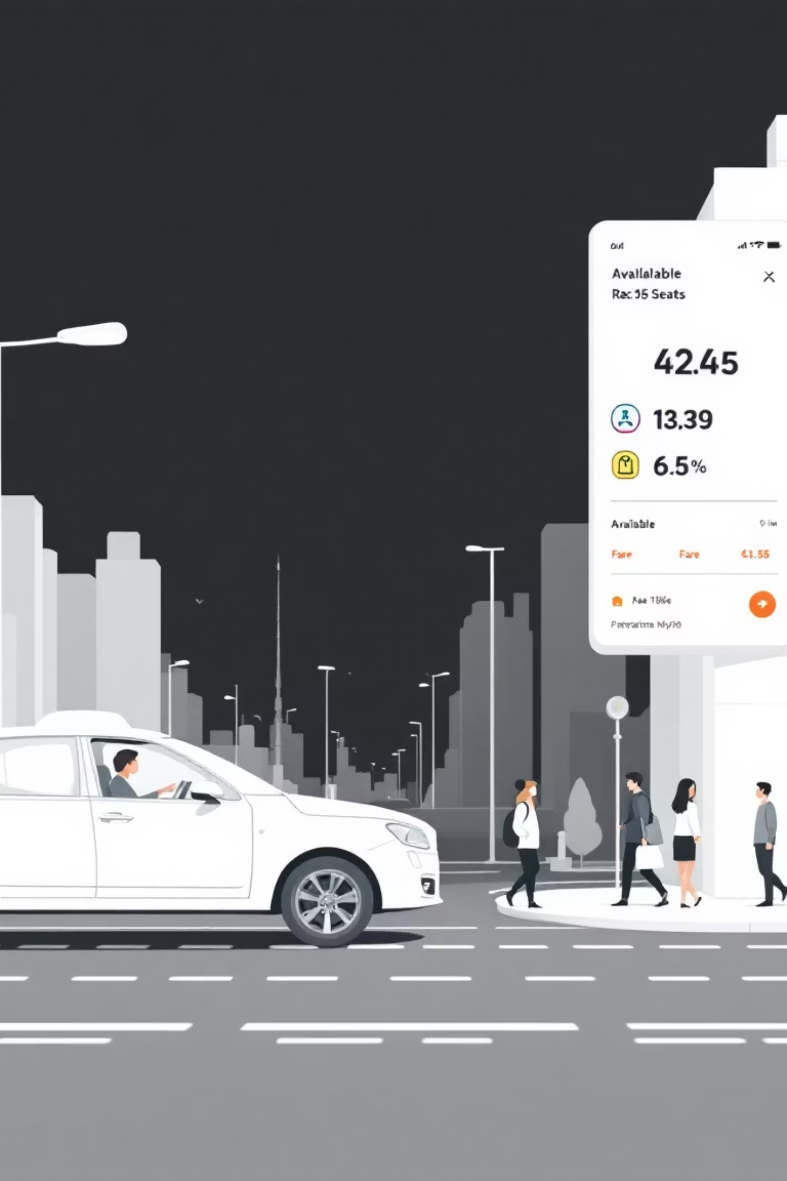
Project Introduction
The Smart Ride Sharing System is a website-based platform where vehicle owners traveling long distances can share their available seats with passengers heading in the same direction. Drivers can post trips and passengers can book seats based on destinations. Features dynamic fare calculation depending on distance traveled. Promotes cost-effective, transparent, and eco-friendly shared mobility while reducing traffic congestion.

Slide 3






Key Platform Features
User Management Module
Ride Posting and Booking Module
Secure registration, profiles, authentication
Trip creation, seat booking
Fare Calculation & Payment Module
Route Matching & Tracking Module
Dynamic pricing, secure payments
Intelligent matching, real-time tracking
Notification and Review System
Admin Dashboard for Monitoring
Alerts, rating system
Oversight, user management

Slide 4








Technology Stack
Backend
Frontend
Spring Boot, Spring Security with JWT authentication, RESTful APIs.
React.js for user interface.
Database
Payment Integration
MySQL
Razorpay.
APIs
Real-time Updates
Google Maps Distance Matrix API for route calculation.
WebSockets or Firebase.
Testing
Postman.

Slide 5




Future Enhancements
AI-Based Ride Matching
Voice & Chatbot Assistance
Predictive algorithms for personalized matching.
Hands-free booking and 24/7 AI support.
Mobile App Integration
Gamification and Rewards
Deeper integration with calendars, payments, smart-city ecosystems.
Loyalty programs for frequent eco-friendly choices.

Slide 6





Challenges & Solutions
Real-time Routing
Overcome with smart algorithms for efficient matching.
Secure Authentication
Implemented using Spring Security with JWT.ca
Dynamic Fare Calculation
Addressed with distance-based fare logic.
Online Payment Integration
Ensured through secure payment gateways.

Slide 7

Conclusion
This project delivers a complete ride-sharing solution built with Spring Boot and React, addressing modern transportation needs through secure bookings, integrated payments, and user-friendly design. It promotes sustainable, community-based travel by reducing vehicles on the road while ensuring transparency, cost-effectiveness, and environmental benefits. The platform will transform how people share rides for long-distance travel.
Thank you

